Slide 1
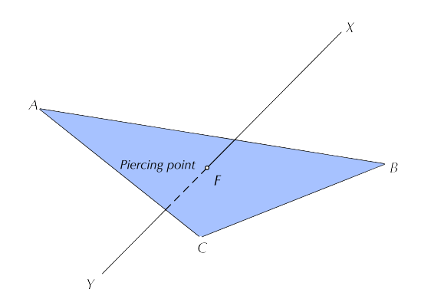
Auxiliary Plane Projection and it’s Applications
Prepared by:
Er. Bibek Magar
BE in Automobile Engineering
IOE, Thapathali Campus
bibek.magar@thc.tu.edu.np

Slide 2
Auxiliary Plane Projection
The principal planes of projection, that is, the vertical, the horizontal and the profile planes are mutually perpendicular. The views projected on these principal planes, known as the principal views, are not sufficient to completely describe those objects that have a number of inclined surfaces in addition to the mutually perpendicular faces.
When the principal views are not enough to provide the required information about the true shape of inclined surfaces of an object, projections on the auxiliary planes, perpendicular to one of the principal planes of projection and parallel to the inclined surface of the object, are used.
An auxiliary plane perpendicular to the HP and inclined to the VP is known as an auxiliary vertical plane (AVP), and one that is perpendicular to the VP and inclined to the HP is known as an auxiliary inclined plane (AIP).
The views obtained on auxiliary planes are known as primary auxiliary views. Let us look at how projections of points are obtained on these auxiliary planes.

Slide 3
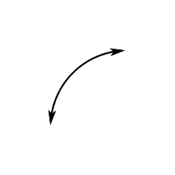
Case I: Projection in the Auxiliary Vertical Plane (AVP)
VP
p’
HP
AVP
P’
p₁’
p_{x}
P
X⁰
X⁰
p
p_{x}
p_{x1}
p_{x1}
p
p₁’
p_{x} p’ = p_{x1} p₁’ (Since both AVP and VP are perpendicular to HP)

Slide 4
Case II: Projection in the Auxiliary Inclined Plane (AIP)
VP
HP
P’
AIP
p_{x1}
P’
p_{x1}
p_{x}
X⁰
p₁
P
p₁
p_{x}
X⁰
p
p
p_{x} p = p_{x1} p₁ (Since both AIP and HP are perpendicular to VP)

Slide 5
Applications of Auxiliary Plane Projection
To determine the true length of line from the given projected views
To determine the true shape of a laminar body from the given projected views
To determine the shortest distance between a point and a line
To determine the shortest distance/ angle between two skew lines
To determine the dihedral angle between two planes
To determine the piercing point between a plane and a line

Slide 6
True Length of a line using Auxiliary View
In the previous chapter, we used the revolution method to obtain true length of a line. Keeping the technicalities of engineering drawing aside, we were just rotating one of the projected views until it was parallel to the another plane such that the counter view represented the true length of the line.
In this chapter, we are going to use the auxiliary view method to obtain the same solution, that is, the true length of the line.
In this method, we simply introduce an auxiliary plane, such that the plane is parallel the required line. This allows us to project the true dimensions of an object, which are otherwise not possible in the principle planes due to the orientation of the object itself.

Slide 7
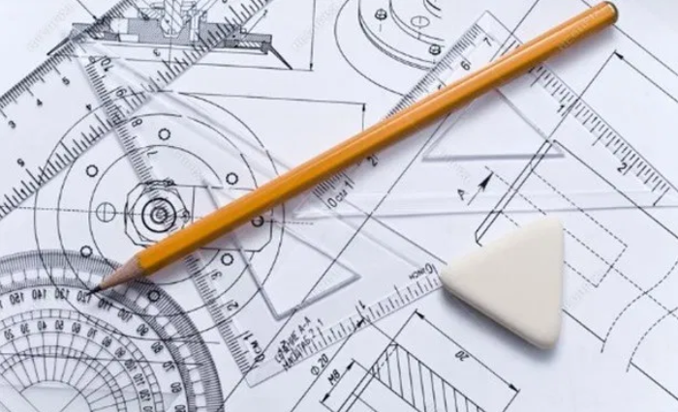
Solved Examples:

Slide 8
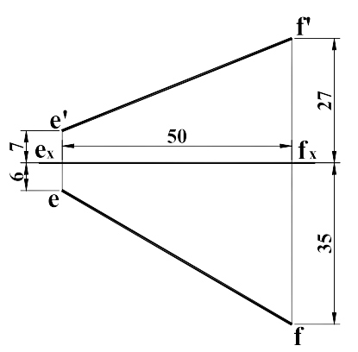
1) Determine the true length and true inclination of the line with VP and HP from the given projection using the Auxiliary View Method.

Slide 10
Draw a reference line x1y1 which separates AIP and VP, and such that it is parallel to the projection e’f’.
61.1637
f1
AIP
Draw projector lines perpendicular to the line x1y1.
28°
y1
VP
e1
Measure the distance x1e1 = xe, and taking x1 as the base transfer the length along the projector passing through x1.
x1
f’
e’
Measure the distance y1f1 = yf, and taking y1 as the base transfer the length along the projector passing through y1.
VP
x
y
HP
e
Connect the points e1 and f1 to obtain auxiliary top view in AIP and measure the true length and true angle with VP.
f

Slide 11
Similarly, draw a reference line x2y2 which separates AVP and VP, and such that it is parallel to the projection ef.
f1
61.1637
AIP
28°
VP
Draw projector lines perpendicular to the line x2y2.
e1
f’
Measure the distance x2e2’ = xe’, and taking x2 as the base transfer the length along the projector passing through x2.
e’
x
y
VP
HP
e
Measure the distance y2f2’ = yf’, and taking y2 as the base transfer the length along the projector passing through y2.
x2
f
e2’
y2
19°
HP
Connect the points e2’ and f2’ to obtain auxiliary front view in AVP and measure true angle with HP.
AVP
f2’

Slide 12
Point View of a Line
In real life, when we observe a linear object perpendicularly, the lateral surface seems to vanish and we see the top surface of that linear object.
We use the same principle to obtain a point view of a line.
In real life we used the real object, that is, the object represented true dimensions. However in the problems, we are presented with projected views which may not represent the true length of the line.
So, the first step to obtain the point view of a line, we must obtain the true length of the line in one of the projected views.
Then, we introduce an auxiliary plane which is perpendicular to the line and the projection of the line in that plane will be represented by a point.

Slide 13
f’
Obtain the true length of the line (e1’f1’ = True Length).
f1, (e1)
e’
Draw a reference line which is perpendicular to the projection representing true length (e1’f1’) and separates the planes AVP and AP1.
AP1
VP
AVP
o
e
HP
Draw end projectors perpendicular to the new reference line passing through point “o”.
x
f
e1’
Measure of1= xe, and oe1 = yf, and taking base “o” find the points f1 and e1 on the projector line passing through “o”. of1 = oe1 (since ef and xy are parallel)
y
HP
AVP
f1’

Slide 14
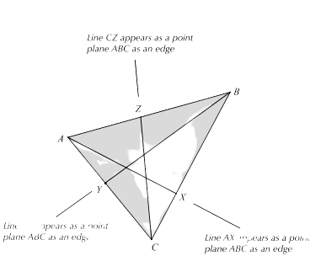
Edge View of a Plane
As a plane is completely and uniquely defined by three non-collinear points on the plane, we can use these points which form the corners of a triangle that belongs to the plane to delineates a bounded portion of the plane. Views of such triangles are generally used in descriptive geometry to define a plane.
Edge view of a plane is the view when you see the plane as a straight line.
In order to see a plane in edge view the viewer must assume a position in space where a line in the plane appears as a point.
To find the point view of any line lying on a plane, we require true length of that line. So we may require to determine the true length of the line beforehand to solve this problem.

Slide 15
General Steps to Obtain Edge View of a Plane
Scrutinize the given views to check if any of the given edges of the given plane are represented as true length or not.
If the true length is represented by one of the sides of the plane, then we convert that edge into a point view, which results in conversion of the plane into an edge view.
If the true length is not represented by one of the sides of the plane, then we construct a line which is represented as true length in one of the principal views. (Generally we assign one of the end of this line as one of the vertex of the plane to avoid projection of an extra point).
While converting the line into point, the plane automatically will turn into an edge view.

Slide 16
Case I: When one of the sides of the plane appear as true length in one of the principal views
Since ac is parallel with VP, projection a’c’ appears as a true length.
a1 (c1)
While converting a’c’ into a point view, plane abc appears as an edge view.
c’
a’
b1
VP
AP
b’
VP
HP
a
c
b

Slide 17
Case I: When none of the sides of the plane appear as true length in one of the principal views
Since none of the sides of the plane are parallel with either of the principle planes, we construct a line( cx) which is parallel to VP, that is, the projection of line in front view appears as true length (x’c’ = True Length).
a1
x1, (c1)
While converting x’c’ into a point view, plane abc appears as an edge view.
b1
c’
a’
x’
AP
VP
b’
VP
HP
a
x
c
b

Slide 18
c’
Alternately,
a’
y’
b’
VP
HP
a
c
y
c1’
b
a1’, (y1’)
HP
b1’
AP1

Slide 19
Shortest Distance Between a Point and a Line
To determine the shortest distance between a point and a line, we convert the one of the projected view into it’s point view.
While converting the line into it’s point view, we introduce various auxiliary planes, and the point is shifted accordingly until the projection of the line is converted into a point.
Finally the given point and the point view of the line is connected and the distance is measured.

Slide 20
Solved Examples:

Slide 21
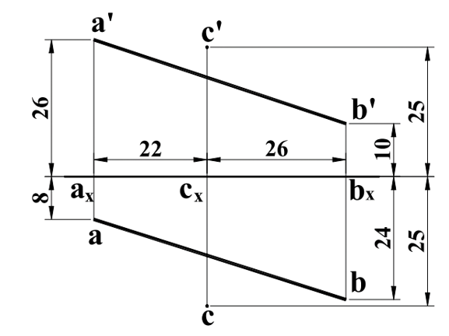
2) Determine the shortest distance between the point C and line AB.

Slide 22
SD
c1
c1’
a1
b1
a1’ (b1’)
AP1
AP2
a’
c’
AP1
VP
b’
VP
HP
a
c
b

Slide 23
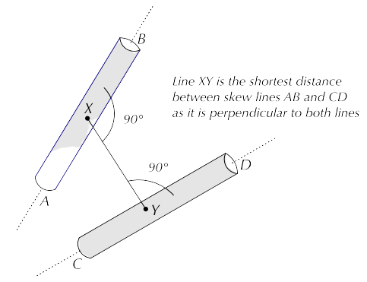
Shortest Distance Between Two Skew Lines
Skew lines are non-intersecting non-parallel lines. Skew lines are parallel to the same plan, but there is no plane in which the two lines are coplanar.
For any two skew lines, there exists exactly one line perpendicular to both lines; this line is called the common perpendicular.
The shortest distance between two skew lines is the distance between their intersection points with their common perpendicular.
This distance can be determined by finding a view in which one of the lines is shown in point view.

Slide 25
Solved Examples:

Slide 26
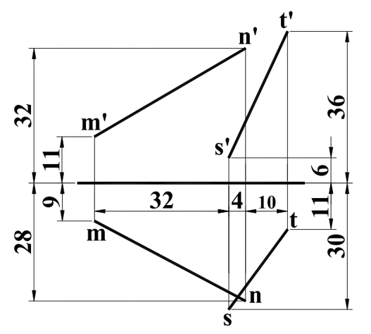
3) Determine the shortest distance between the lines MN and ST.

Slide 27
s’
AP2
AP1
m’, n’
t’
n
AP1
s
t
VP
n’
t’
m
m’
s’
VP
HP
m
t
n
s

Slide 28
True Shape
To determine the true shape of a plane, we should convert on of the projected views into an edge view.
Then, we should introduce an auxiliary plane which is parallel to the edge view, that is, parallel to the plane of the inclined surface.

Slide 29
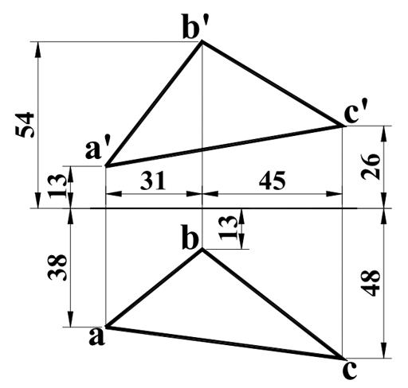
4) Reproduce the given views of the plane and draw the view showing the true size and shape.

Slide 30
b’
x’
Obtain edge view of the plane ABC.
c’
a’
Introduce an auxiliary plane parallel to the edge view, so that the projection obtained in it’s counter view depicts the true shape of plane ABC.
VP
b
HP
x
HP
AP1
a
c
b1’
AP1
x1’, (c1’)
AP2
a1’
c1
b1
TS
a1

Slide 31
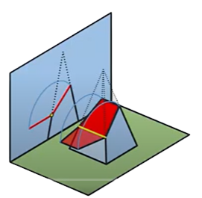
Dihedral Angle
In three dimensional geometry, two planes can directly or indirectly (by extension) intersect each other. The angle formed between the intersection of two different planes is called a dihedral angle. In other words, we can say that the interior angle between the two planes is known as a dihedral angle.
To obtain the dihedral angle between two planes, we should convert the common line (line of intersection between two planes) into a point view.
While converting the common line into a point view, the planes convert into edge views.
Thus the interior angle formed between the two edge views is the required dihedral angle.

Slide 32
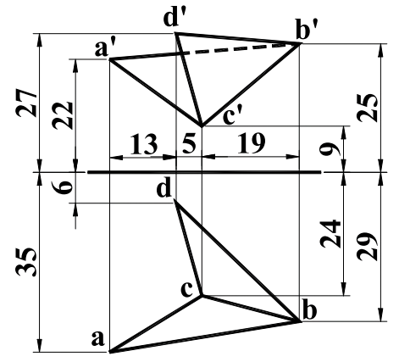
5) Determine the angle between the planes ABC and BCD.

Slide 33
c1’, (b1’)
AP2
a1’
Determine the true length of the common line BC.
AP1
77°
d1’
Obtain the point view of line BC. By doing so, we also obtain the edge views of planes ABC and BCD.
b1
AP1
a1
VP
The interior angle formed between the edge views is the required dihedral angle between the given planes.
c1
d1
d’
b’
a’
c’
VP
d
HP
c
b
a

Slide 34

Piercing point: Intersection between lines and planes
When a line neither on nor parallel to a plane intersects that plane, it does so at a point called the piercing point.
A piercing point is the location about which a line segment changes it’s position relative to (i.e., behind or in front of) the plane it pierces.
So in this type of problem, at first we need to locate the piercing point and then test the visibility of the line due to it’s relate position to the plane it pierces.
Although there are multiple methods to approach this problem, we are going to use the edge view method to solve this problem.
Obtaining the edge view of the plane facilitates us to view the intersection point between the edge view of the plane and the given line, which is the required piercing point.

Slide 35
Step 1: Determining the location of the piercing point
b
At first we obtain the edge view of plane ABC, and simultaneously trace the projection of line 12 while doing so.
1
z
When we obtain the edge view of plane ABC, we also obtain the piercing point Z.
2
b1
a
c
HP
11
VP
b’
z1
Then we draw projectors backwards to obtain the piercing point, that is, find the intersection point between the projector of Z and line 12.
a1, (c1)
1’
21
z’
c’
2’
AP1
a’
VP

Slide 36
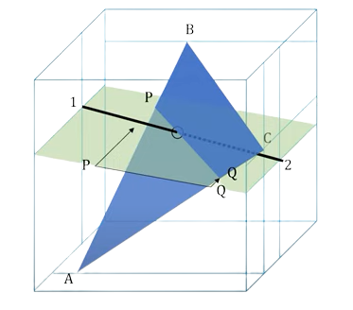
Step 2: Test of visibility of various segments of the line
b
p
1
z
2
q
b1
a
c
11
HP
VP
b’
z1
1’
P’
a1, (c1)
z’
c’
21
q’
Projecting plane containing points P and Q, which is perpendicular to VP, we found that point P is behind the line 12, and point Q is in front of line 12. Thus line segment p’z’ is a drawn as a solid line and z’q’ is drawn as a hidden line.
2’
a’
VP
AP1

Slide 37
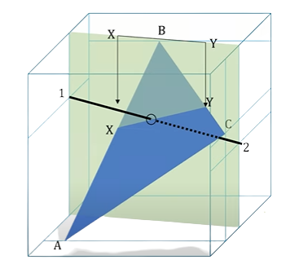
Step 2: Test of visibility of various segments of the line (Continued)
b
1
x
z
y
2
b1
a
c
11
HP
VP
b’
z1
1’
y’
a1, (c1)
x’
z’
c’
21
Projecting plane containing points X and Y, which is perpendicular to HP, we found that point X is below the line 12, and point Y is above of the line 12. Thus line segment xz is a drawn as a solid line and zy is drawn as a hidden line.
2’
a’
VP
AP1

Slide 38
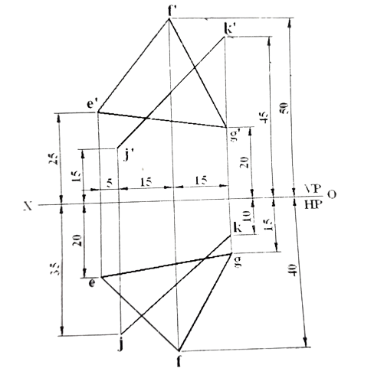
6) Determine the piercing point between the plane EFG and line JK. Also determine the visibility of the line

Slide 39
f’
f1
k’
k1
P’
p1
e’
x’
e1, (x1)
g’
g1
j’
j1
VP
VP
AP1
HP
k
g
e
p
x
j
f

Slide 40


